Slide 1
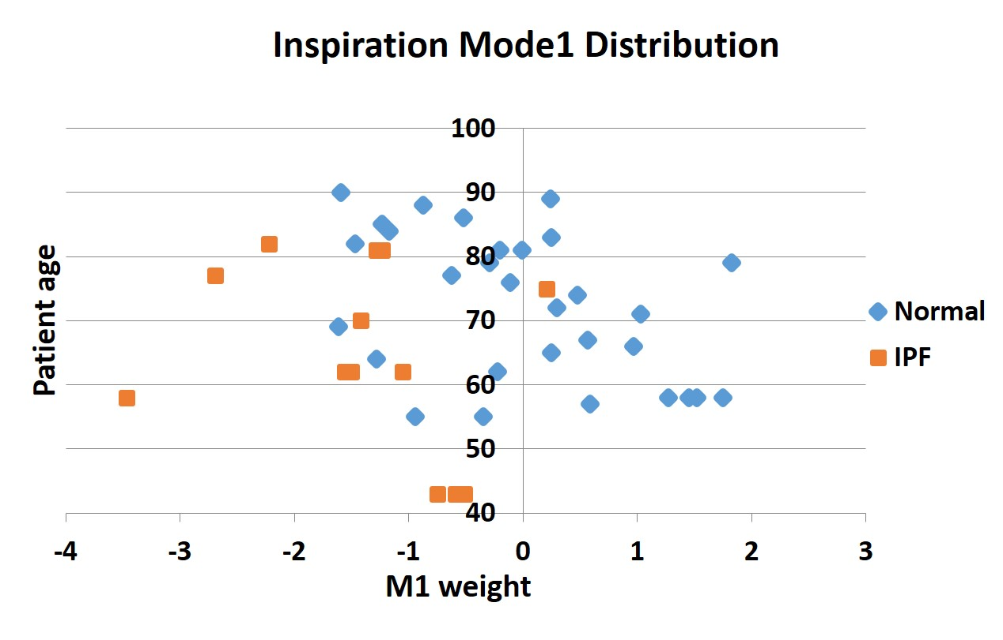
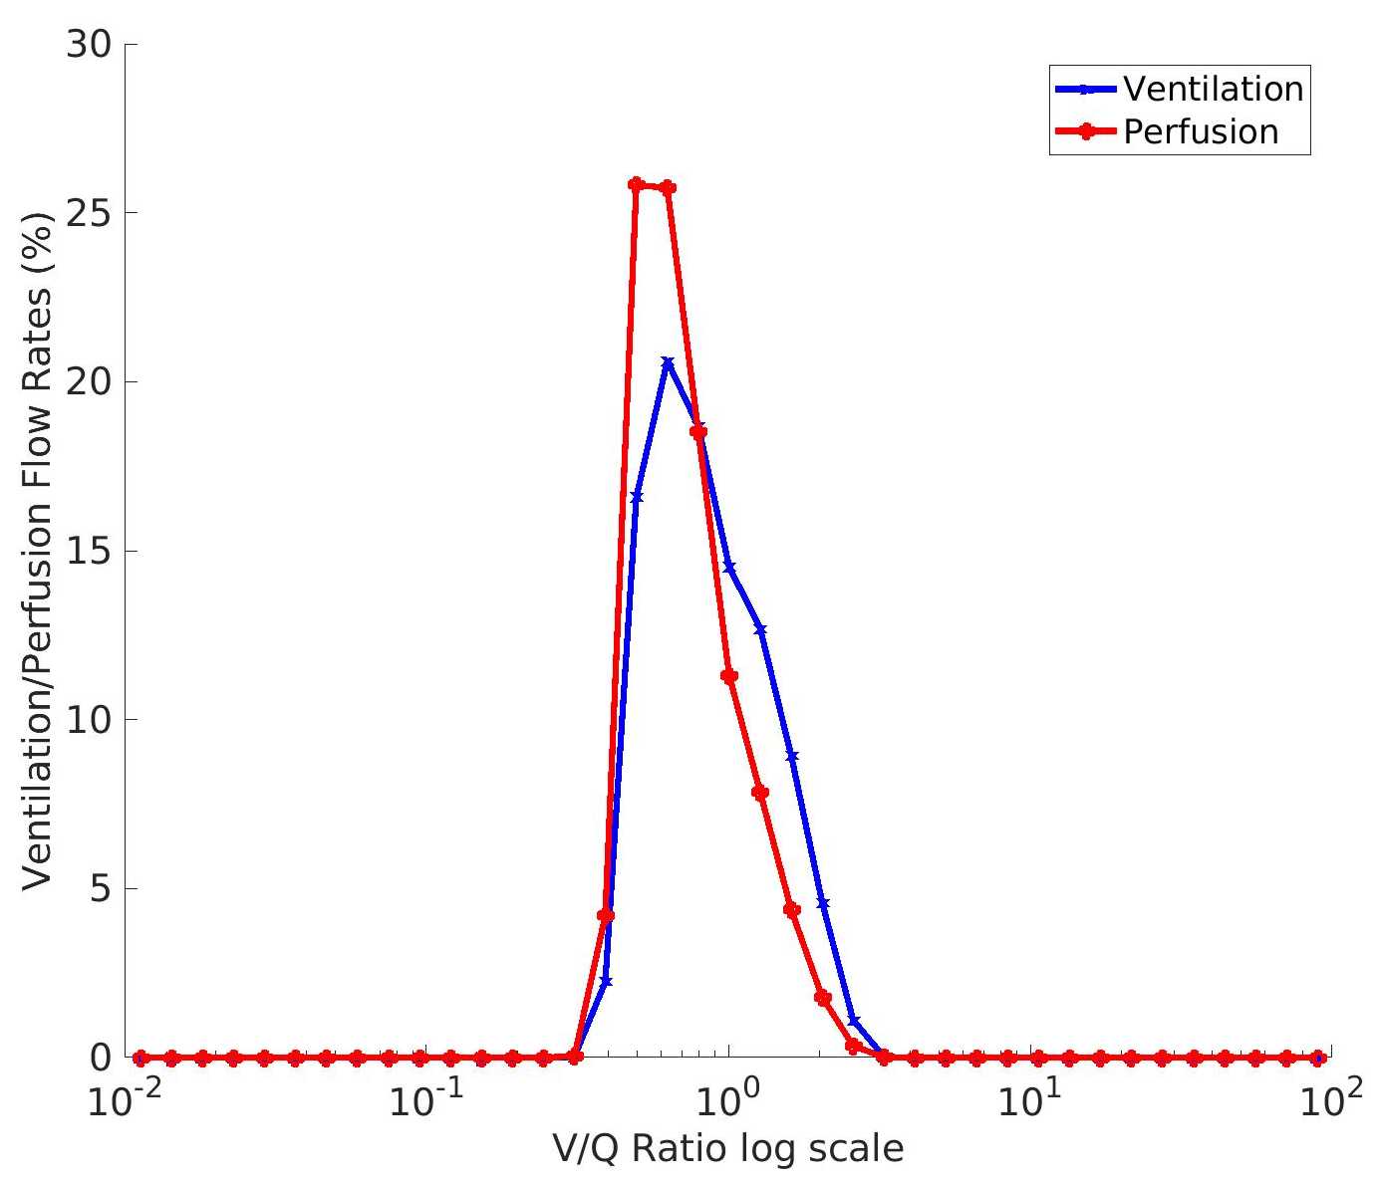
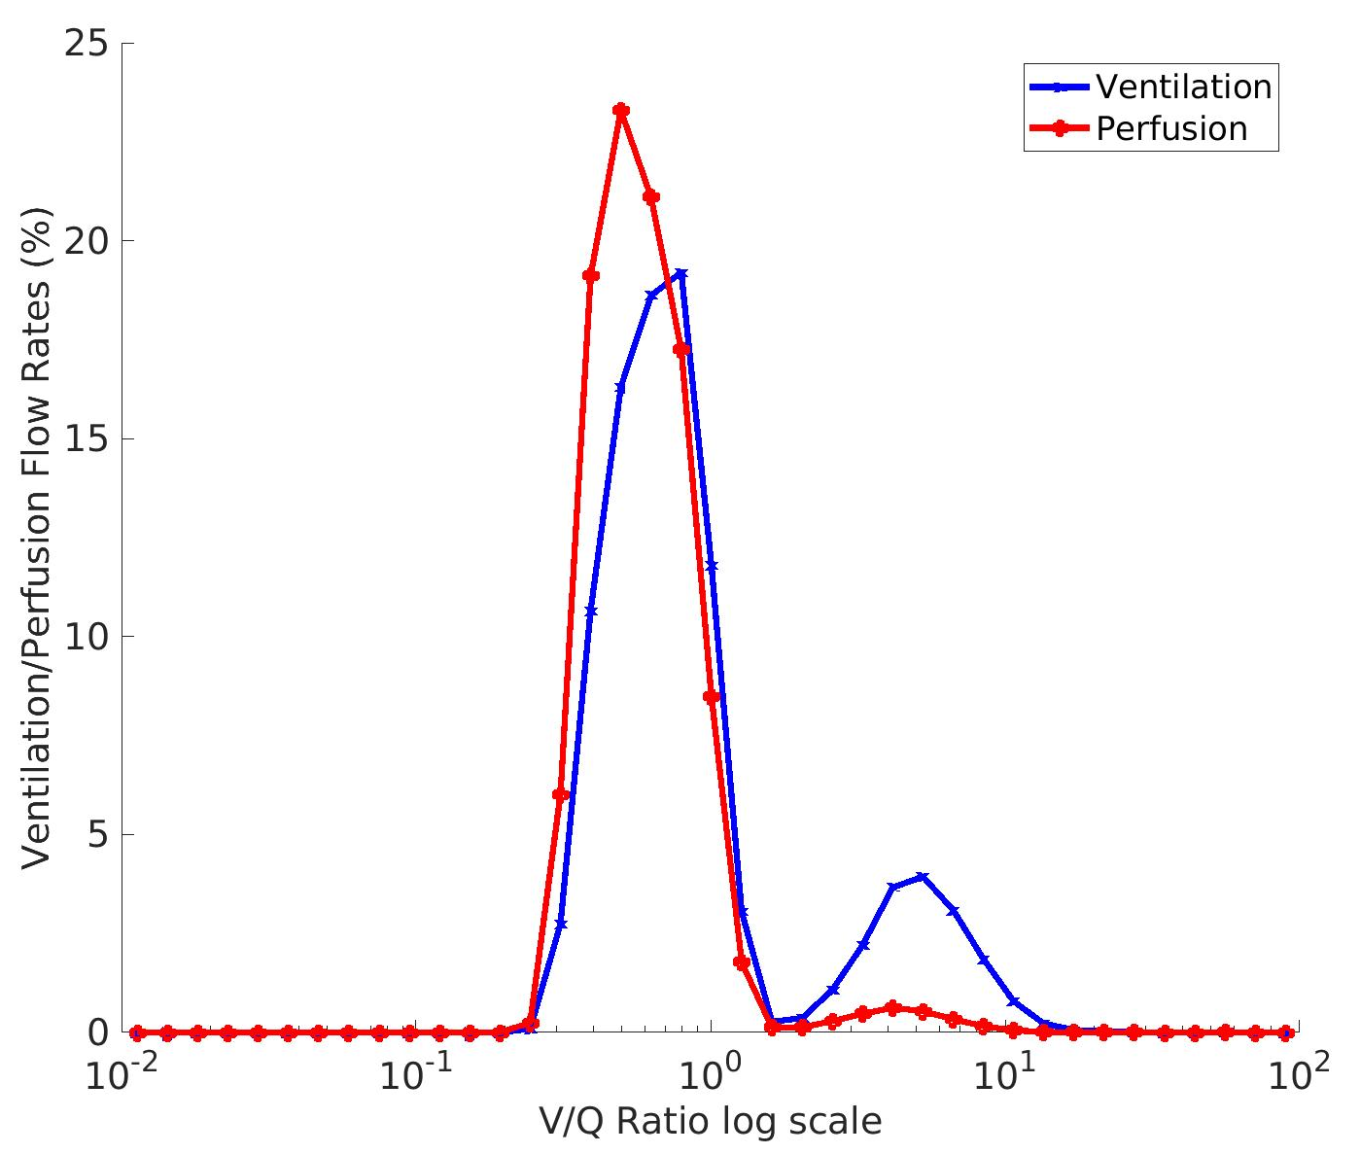
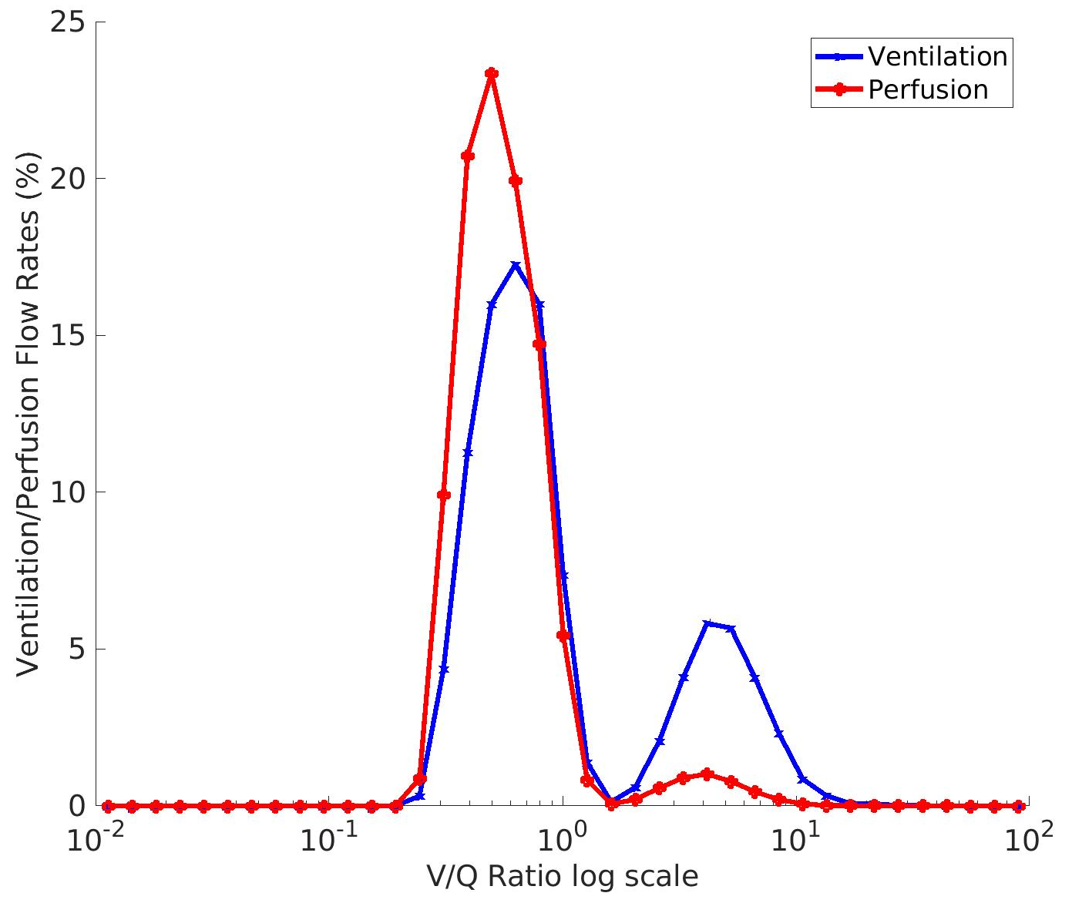
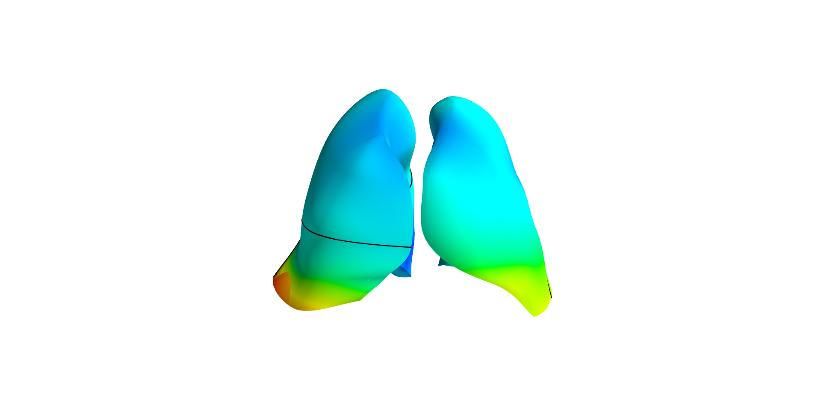
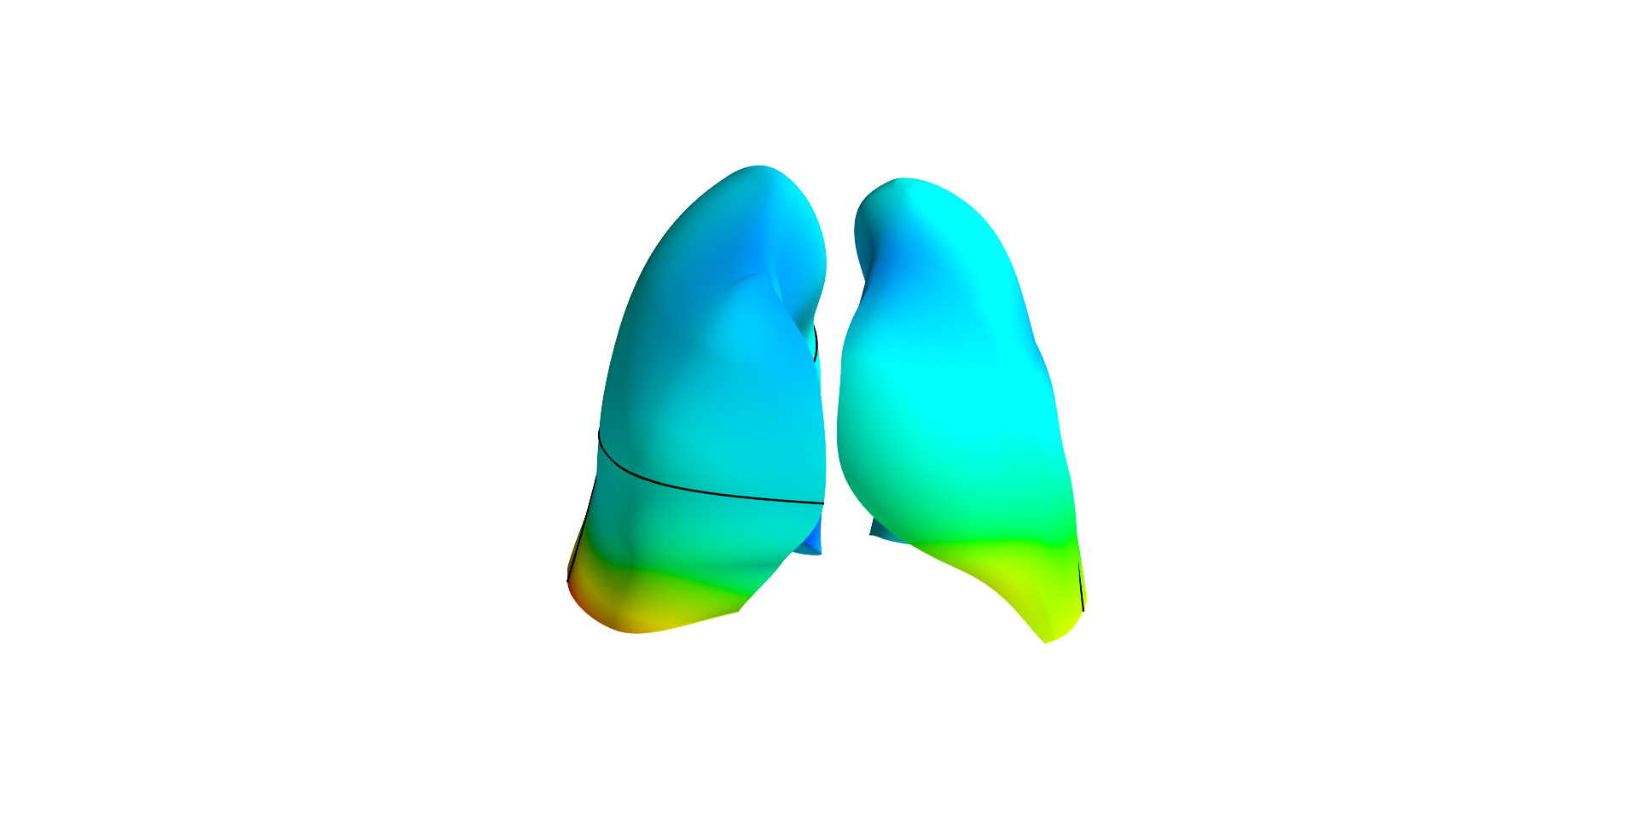
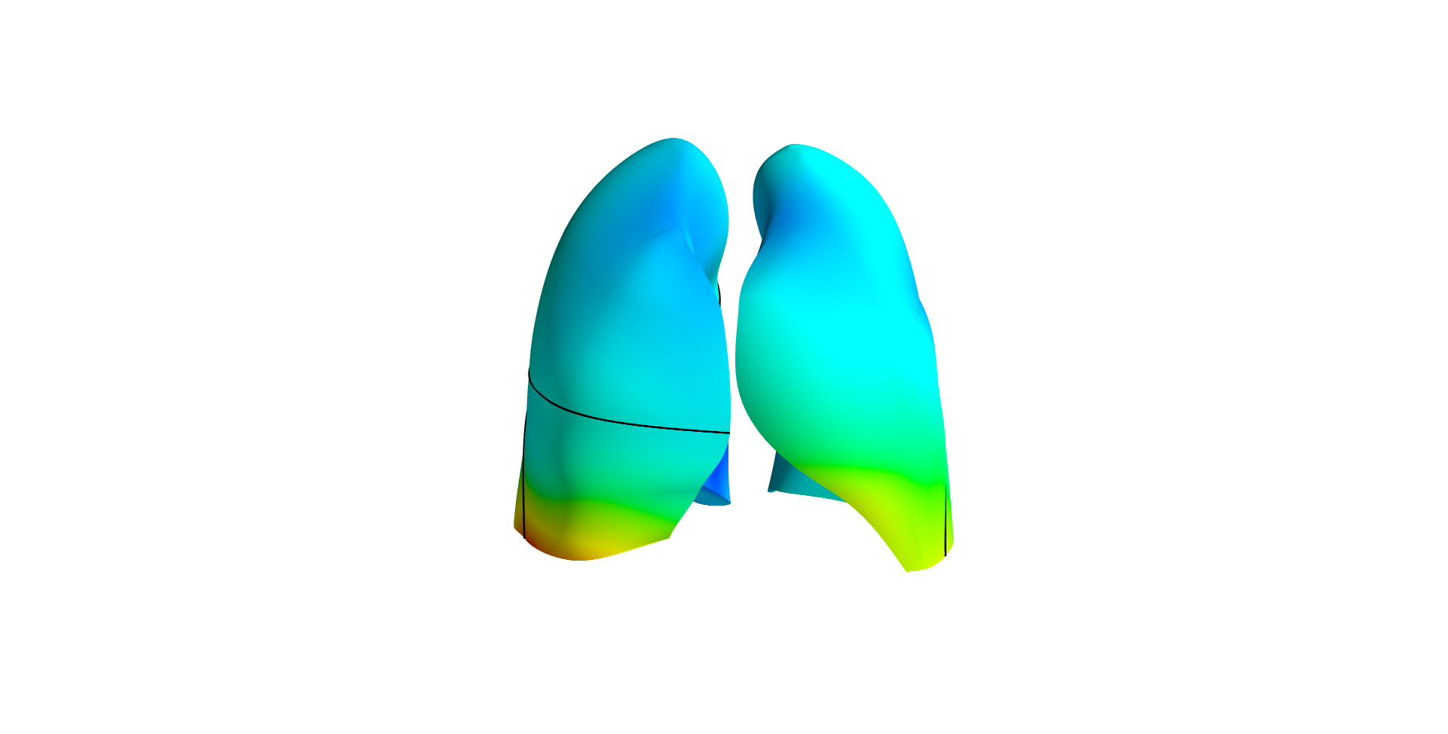
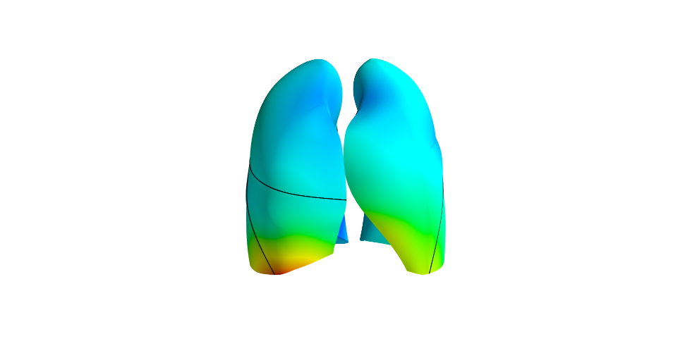
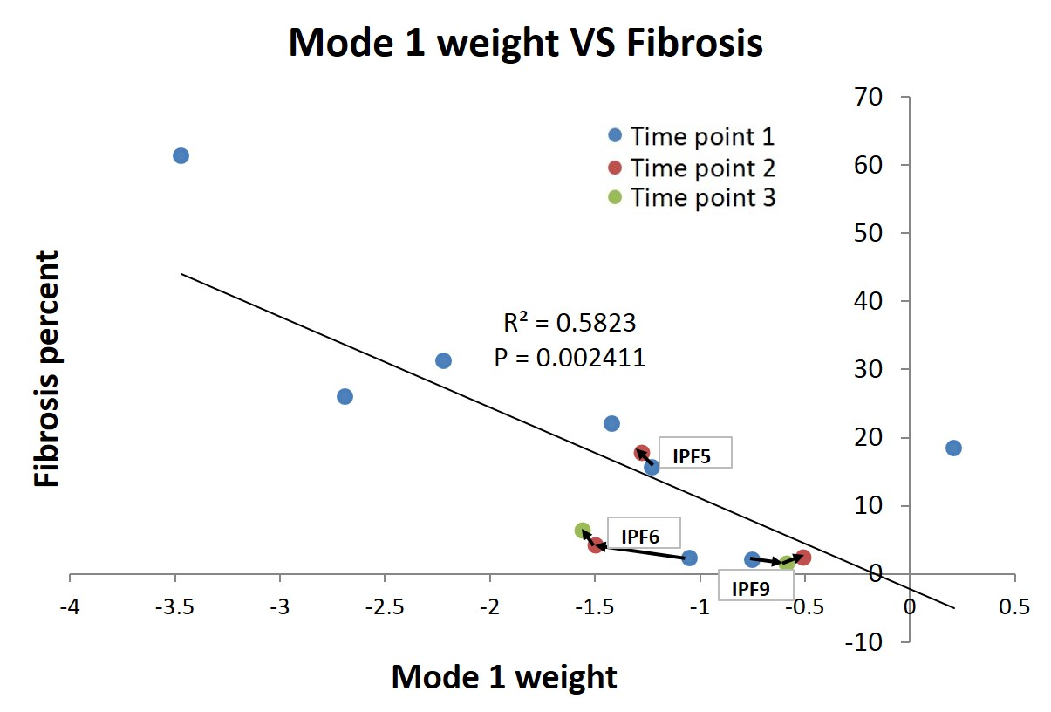
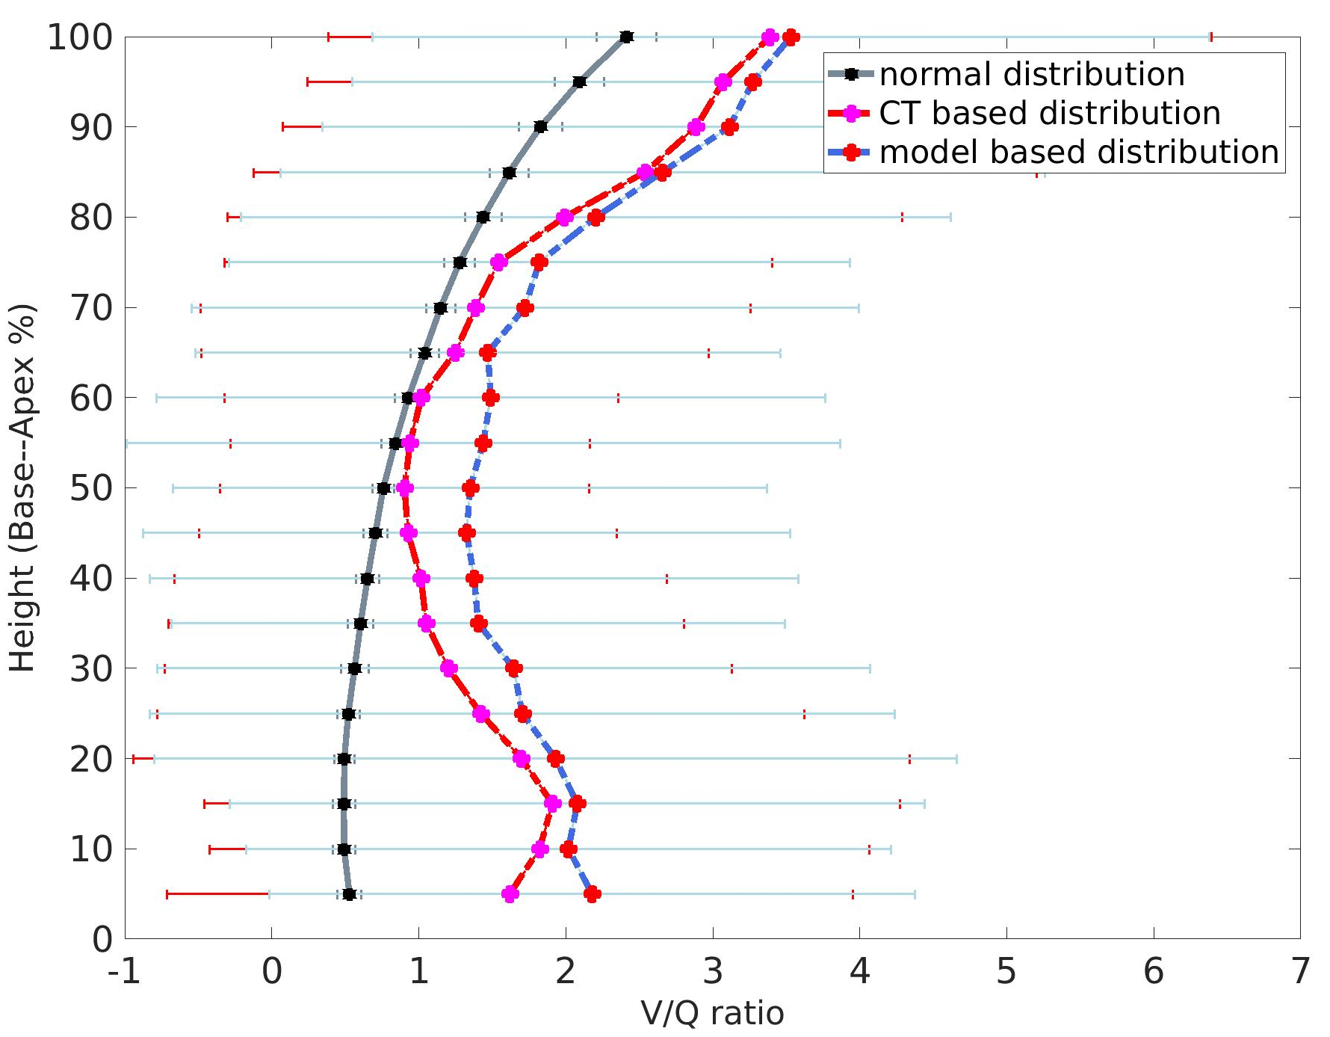
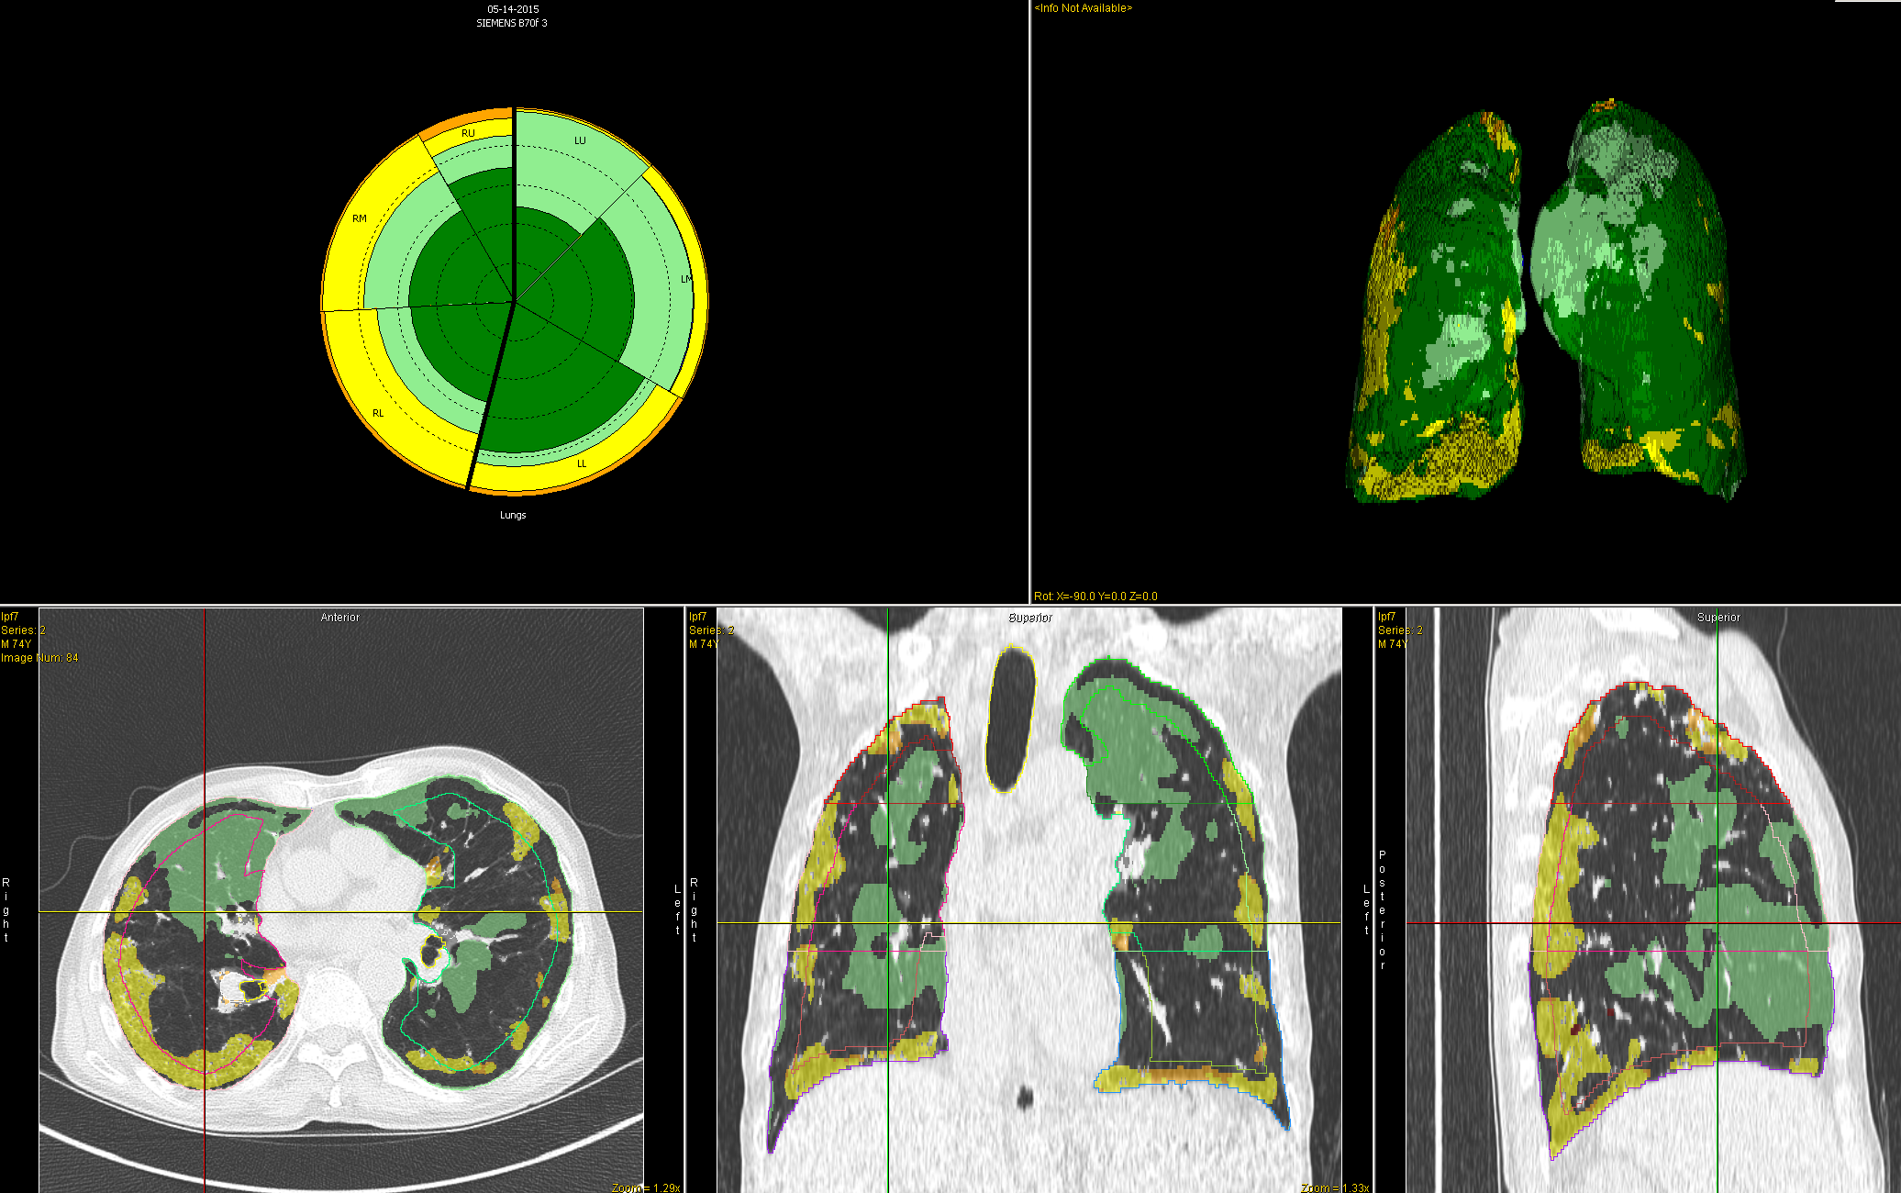
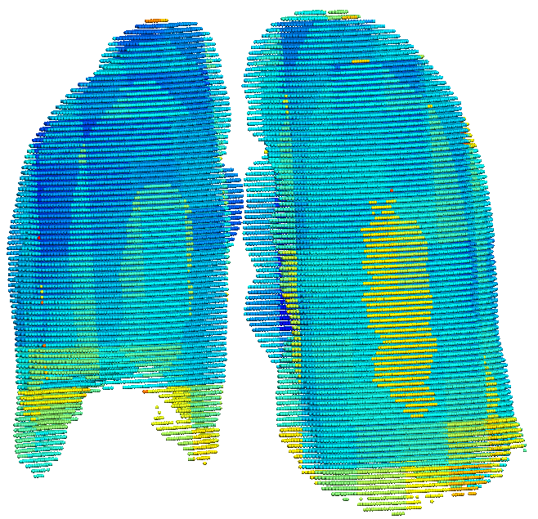
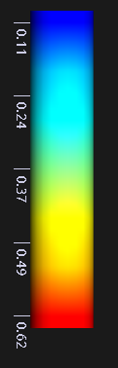
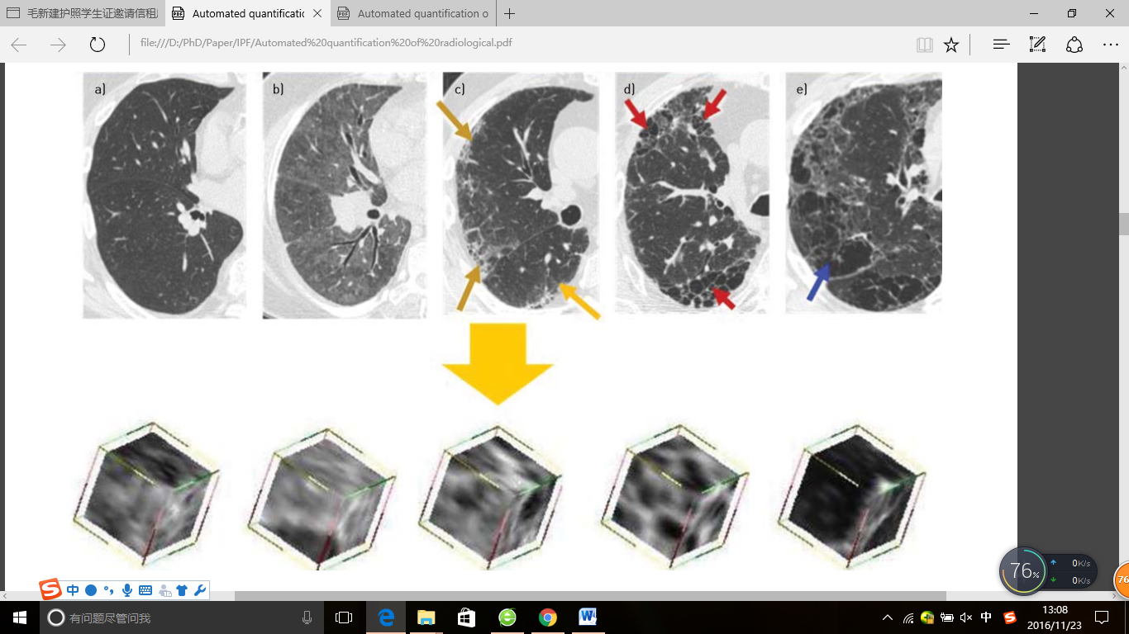
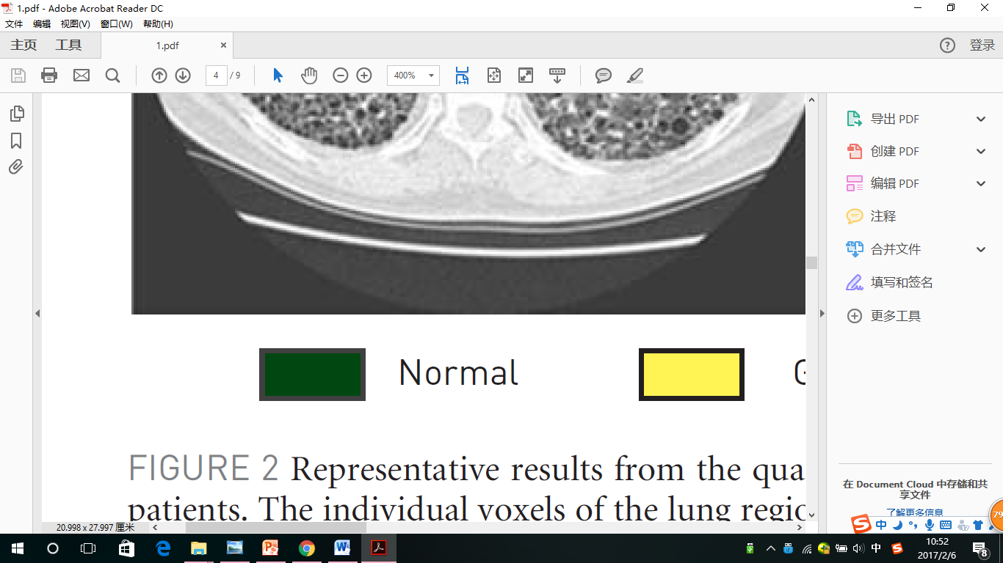
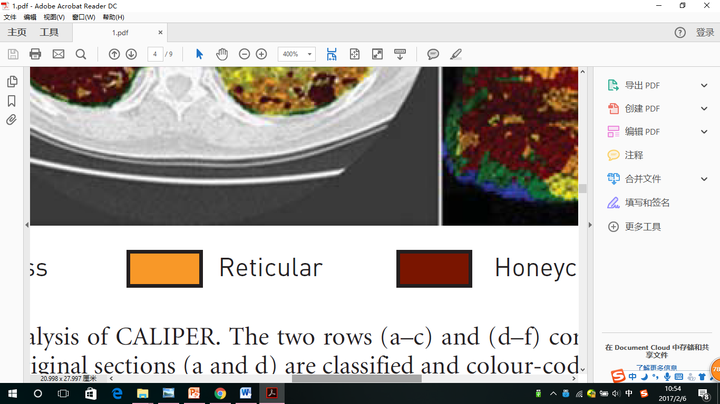
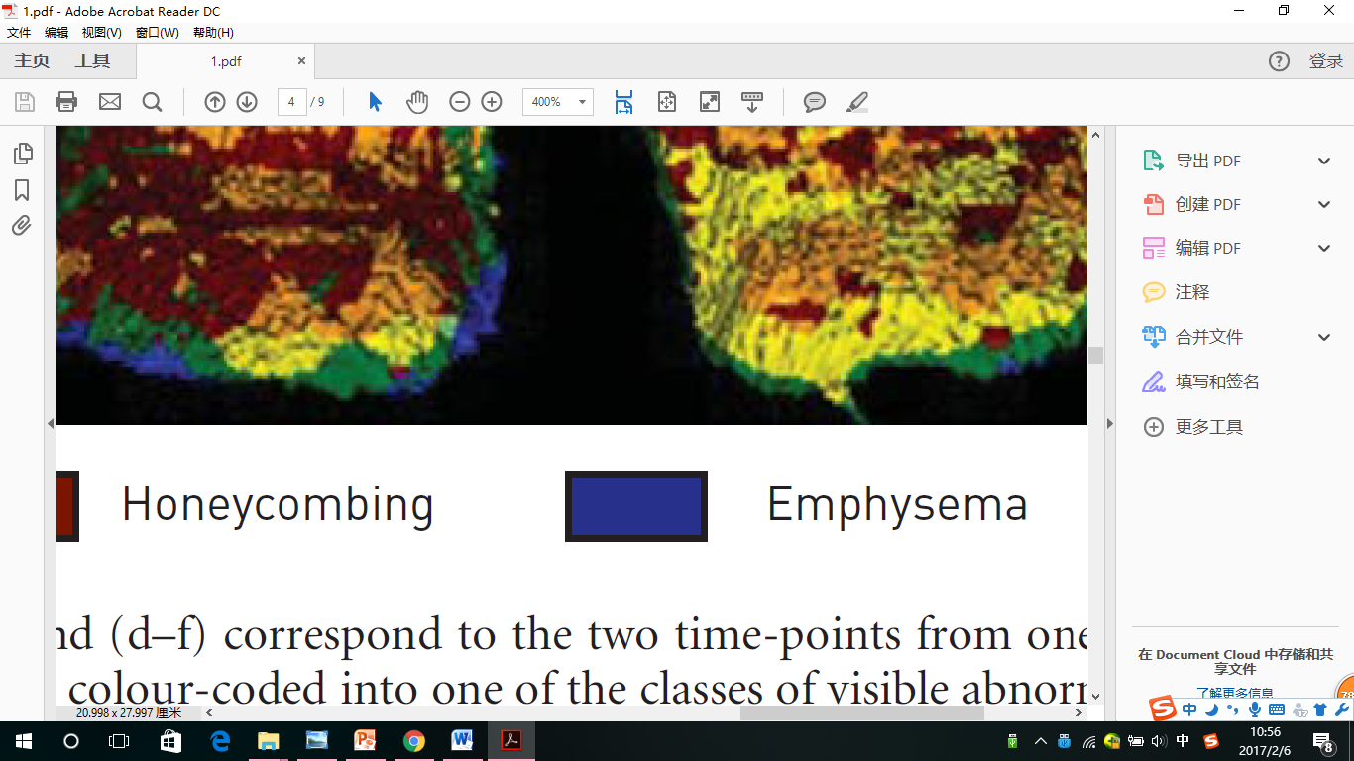
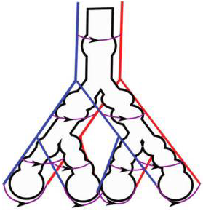
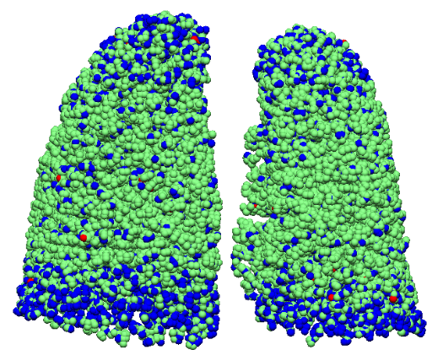
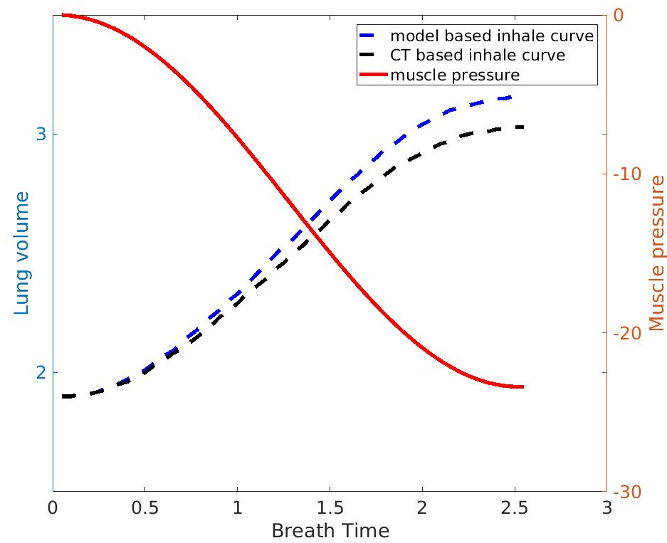
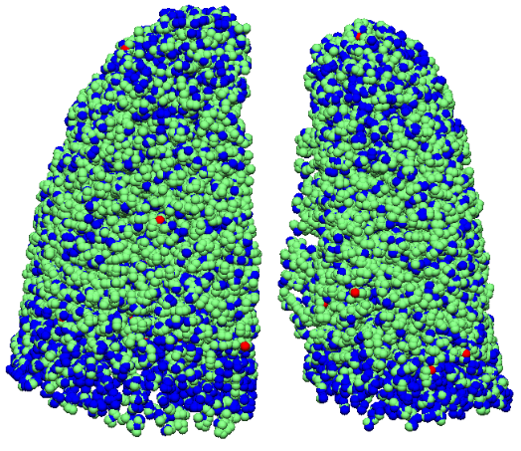
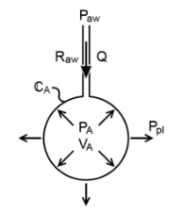

Idiopathic pulmonary fibrosis: a study using volumetric imaging and functional data in a computational lung model
Y. Zhang¹, A. R. Clark¹, H. Kumar¹, M. Wilsher², D. Milne², C. King², B. J. Bartholmai³, M. H. Tawhai¹
¹Auckland Bioengineering Institute, University of Auckland, New Zealand, ²Auckland City Hospital, Auckland, New Zealand, ³Department of Radiology, Mayo Clinic, Rochester MN
Background
Idiopathic pulmonary fibrosis (IPF) is an aggressive idiopathic interstitial pneumonia, and often occurs in elderly adults. In IPF, fibrosis typically develops preferentially in posterior-basal lung regions, and often co-exists with emphysema. Currently it is not clear how - or whether - the spatial distribution of tissue abnormalities in IPF (including classifications of tissue type) correlate with pulmonary function tests (PFTs) and their change over time.
This work aims to develop a new quantitative tool that integrates data from volumetric imaging, PFTs, and computational models for lung function, to understand differences between IPF and normal older lungs.
Statistical shape model (SSM) analysis
Simulating IPF lung function
CT-based lung shape compared statistically to a cohort of normal older subjects via a statistical shape model (SSM) that was derived using a principal component analysis.
Older normal
CT based
Model based
The older normal model predicts normal V & Q distributions, with P_{a}O₂ of 89.0 mmHg, typical of a normal older adult.
The model with CT-based tissue predicts characteristic bimodal V & Q distributions, and P_{a}O₂ moderately decreased (78.1 mmHg).
CT-based fibrosis alone results in more compliant lung than expected from patient data, and a moderately impaired gas exchange function.
-3 SD of Mode 1
-2 SD of Mode 1
Mean shape (older normal)
+2 SD of Mode 1
The most significant variation in shape (mode 1 of the SSM) relates to the anteroposterior diameter of the lung, and the ratio of apical to basal diameters. >20% of shape variation is captured by this shape mode.
Mode 1 of the SSM is significantly different between IPF and normal subjects and correlates with percent of fibrosis (p<0.01).
There is a significant difference of right lower and right middle lobe volumes between normal old and IPF lungs (p<0.001, p<0.001 respectively).
Ç
Tissue classification and Quantification
Computed tomography (CT) and pulmonary function tests (PFT) data acquired retrospectively from eight patients diagnosed with IPF at Auckland City Hospital, Auckland, New Zealand.
All patients scanned at initial examination, and four with follow-up scans between 5-20 months.
By increasing the elasticity of a small proportion of ‘normal’ tissue, the model predicts appropriate patient-specific FRC and TLC, and decrease in P_{a}O₂ to 72.9 mmHg.
Patient-specific modelling of IPF
Step 1: Model generation
CALIPER analysis and densitometry –
Fibrosis has consistently higher tissue density (0.34/0.41 for reticular/ground-glass) compared to normal tissue (0.28). Emphysema has lower density (0.08).
Fibrosis predominantly in lower lobes (72%, 58%, 65% for honeycomb, reticular, ground-glass). Emphysema predominantly in upper lobes (73%).
Distribution of fibrosis is basal, peripheral, patchy.
Upper airway and blood vessels from CT mapped to SSM model of normal older lung
Summary
We classified the pulmonary parenchyma representing IPF features and performed quantitative analysis of IPF lungs.
Statistical shape analysis suggests quantifiable differences from normal in lung shape are present in IPF, and correlate with extent of fibrosis.
V/Q mismatch (impaired gas exchange) present in ‘normal’ tissue as well as regions that are classified as abnormal.
Ç√
Anatomically based airway and blood vessel trees are generated
Individual’s tissue classification from CALIPER is mapped to patient model
Normal Ground-glass Reticular Honeycomb Emphysema
Step 2: Model solution
CT- based fibrosis: 17.64%
Model- based fibrosis: 29.75%
Tissue classified as normal, ground glass, reticular, honeycomb or emphysema using CALIPER* classification based on signature mapping techniques.
‘Older normal’, a normal individual of equivalent age (80 y.o.), with patient- specific muscle pressure
‘CT-based’ tissue classification mapped to model, with fibrosis reducing tissue compliance and narrowing vessels
References [1] Swan, A.J., A.R. Clark, and M.H. Tawhai, J Theor Biol, 2012; [2] Clark, A.R., et al., J Appl Physiol (1985), 2011
Acknowledgements Clinical data for this study was provided by Drs ML Wilsher and DG Milne, Auckland City Hospital; CALIPER analysis was conducted by Dr B Bartholmai, The Mayo Clinic.
Ventilation [1] and perfusion [2] simulated in subject-based model
‘Model-based’ has additional damage added to CALIPER classified ‘normal’ tissue until a patient-specific pressure-volume curve can be matched by the model
* (CALIPER - Computer-Aided Lung Information for Pathology Evaluation and Ratings)
Notes:
1

